Slide 1


Hybrid Adversarial Defence Mechanisms for Real-Time ML Security in Critical Systems
A New Approach to Protecting Real-Time Systems from Attacks
Course Code: CSE 4531
Presented By
Abubakkar Siddique
ID: 011201329
Saif Uddin
ID: 011213202
Presented To
Dr. Md. Shohrab Hossain
Professor, Dept. of CSE
United International University
1

Slide 2
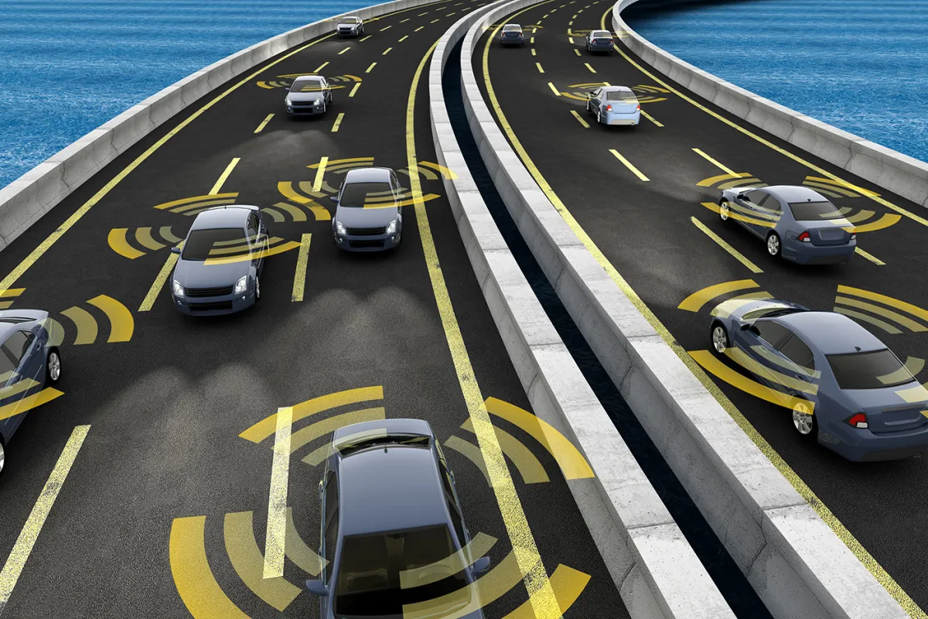
Introduction
United International University | 2025
Context:
ML is everywhere now — in self-driving cars, hospitals, factories, and security.
These systems depend on ML to make quick decisions so they must be fast and trustworthy.
A big danger: Adversarial attacks — tiny changes in input that trick ML models, even though they look normal to humans
Problem:
Vulnerable Defenses
Slow Defenses
These fail against sophisticated attacks, leaving systems exposed.
These are not suitable for real-time use, limiting their effectiveness against immediate threats.
Fig 1. The cybersecurity risk of self-driving cars.
Is self driving car hackable?
2
@IEEE spectrum

Slide 3
United International University | 2025
Existing Research Analysis
Characteristic
Description
Defense Effectiveness
No single defense works well against all attacks.
Ensemble Training
Improves robustness but is slow and costly.
Preprocessing Speed
Fast preprocessing reduces clean accuracy.
Hybrid AI Performance
Works better than single-method approaches.
Real-World Application
Lacks real-world use across domains.
Dynamic System Performance
Fails in dynamic, real-time systems.
Edge Device Compatibility
Edge devices need lightweight, smart defenses.
Data Type Flexibility
Improves vision systems but not other data.
Privacy Connection
Connects attacks to privacy issues; limited to social networks.
Combined Attributes
Few defenses offer robustness, speed, and domain flexibility together.
3

Slide 4
United International University | 2025
Research GAP
One-Sided Focus
Defenses target single aspect, neglecting others
Slow Performance
Strong defenses are impractical due to speed
Weak but Fast
Quick methods are vulnerable to strong attacks
Image-Only Focus
Research neglects text and audio data
Poor Generalization
Defenses fail against unseen attack types
Single-Method Limitations
No approach balances solutions across domains
4

Slide 5
United International University | 2025
Objectives for Adversarial Defense
Identify Weaknesses
Balance Robustness and Latency
Compare Performance
Analyze current defense methods to find vulnerabilities
Design Hybrid Framework
Test on CIFAR- 10
Assess the hybrid method against individual techniques
Evaluate Trade-offs
Ensure the system is both secure and fast
Develop a combined defense strategy
Evaluate the framework using white-box and black- box attacks
Check the feasibility by considering computational cost and robustness
5

Slide 6
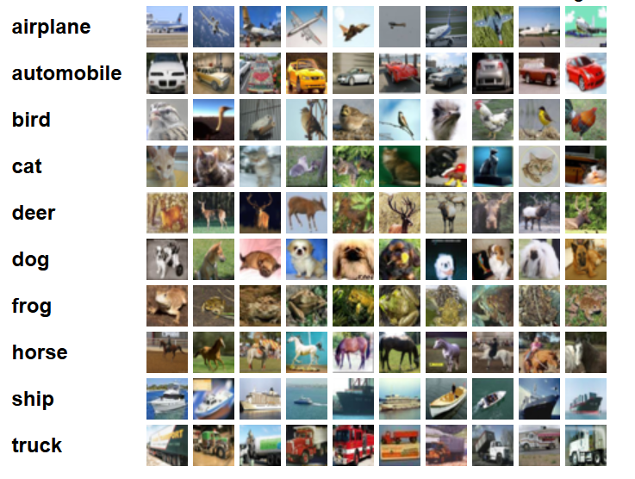
Dataset

Slide 7
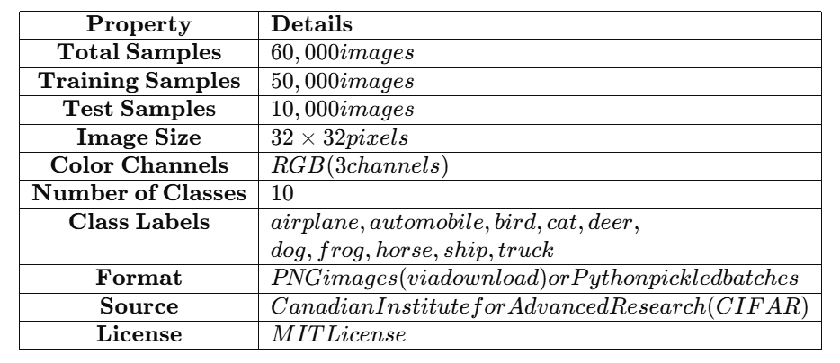
Dataset

Slide 8
United International University | 2025
Hybrid Defense System Motivation
Hybrid Defense System
Combines strategies for real-world needs
Need for Unified Solution
Requires broad, real-time, cost- effective defense
Limitations of Defenses
Current defenses lack unified approach
Vulnerability to Attacks
ML systems vulnerable to adversarial attacks
Critical Applications
ML used in healthcare, cars, cybersecurity
6

Slide 9
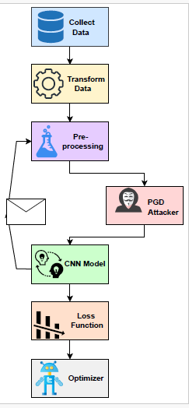
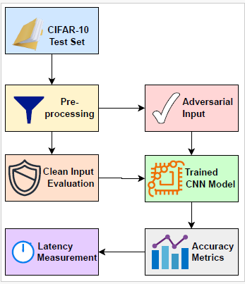
United International University | 2025
Adversarial Training Pipelining
Hybrid Adversarial Testing Pipelining
7

Slide 10
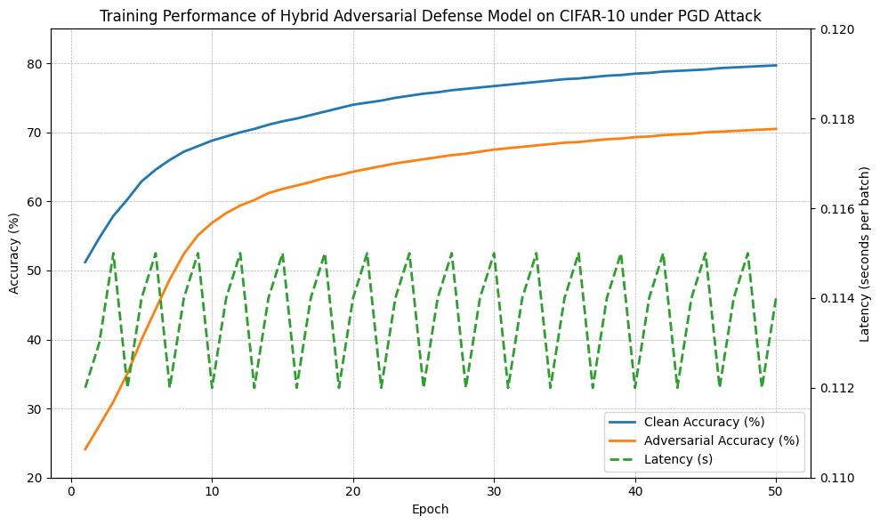
United International University | 2025
Result
8

Slide 11
References
United International University | 2025
Adversarial Attacks and Defenses in Deep Learning. Available at: https://dl.acm.org/doi/10.1145/3547330
Ensemble Adversarial Training: Attacks and Defenses. Available at: https://arxiv.org/abs/1705.07204
Countering Adversarial Images Using Input Transformations. Available at: https://openreview.net/forum?id=SyJ7ClWCb
Advanced Hybrid Techniques for Cyberattack Detection and Defense. Available at: https://www.researchgate.net/publication/384547803_Security_and_Privacy_Advanced_Hybrid_Techniques_for_Cyberattack_Detection_and_Defense_in_IoT_Networks
Hybrid Machine Learning Models Combining Support Vector Machines and Deep Reinforcement Learning for Cyber Defense. Available at: https://www.rademics.com/upload/1741331243133862273767ca9b2b63ac6chapter%202.pdf
Cyberattack Detection in Wireless Sensor Networks Using a Hybrid Intelligent Model. Available at: https://journalofbigdata.springeropen.com/articles/10.1186/s40537-023-00870-w
9

Slide 12

Introduction
Context:
Machine learning is used in many important areas like self-driving cars and medical tools.
Problem:
Bad people can trick these systems by using tiny changes that confuse the machine, it called adversarial attacks.
Objective:
We propose a new defense method to protect machine learning systems from these tricks, especially in real-time.
Fig 1. The cybersecurity risk of self-driving cars.
Fig 2. A stop sign with a small alteration making system misclassify.
Is self driving car hackable?
@IEEE spectrum

Slide 13
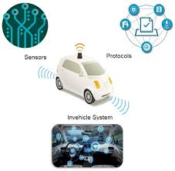
Motivation
Adversarial Attacks:
Small data changes can make systems fail (e.g., stop sign changed to confuse the car).
Real-Time Needs:
Critical systems like cars or medical tools need decisions made immediately.
Research Gap:
Current defenses are slow or only work for one data type.
Impact:
Our solution makes systems safer and more reliable in the real world.
Fig 3. Autonomous Vehicles Attack Surface

Slide 14
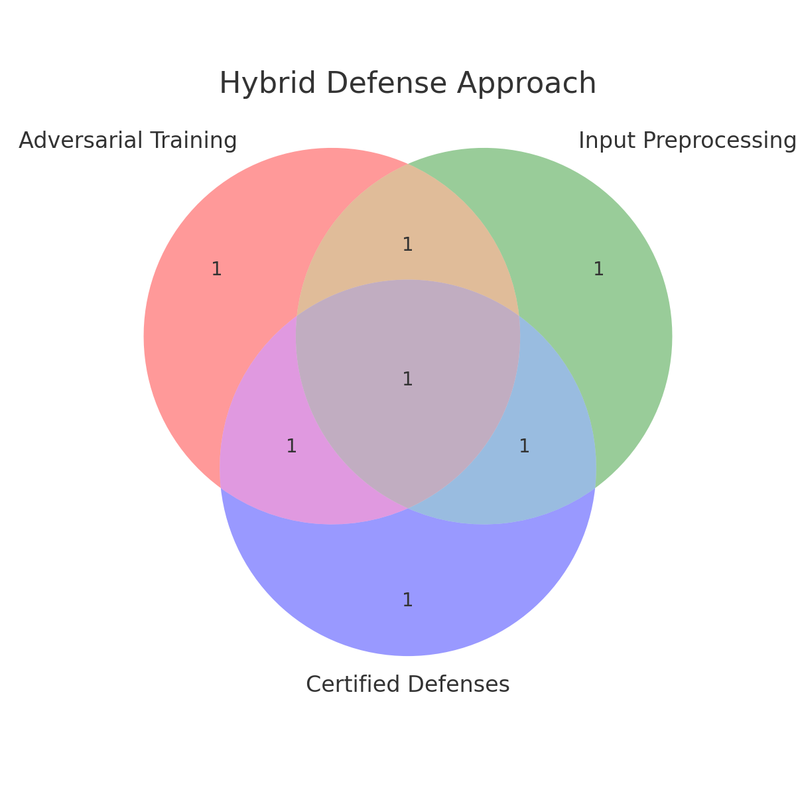
Research Objective
Problem:
Adversarial attacks hurt critical systems.
Solution:
Hybrid Defence by combining:
Adversarial Training: Teach the system to fight attacks.
Input Preprocessing: Clean data before use.
Certified Defences: Ensure the system is safe.
Goal:
Make it work in real-time across multiple data types.

Slide 15



Novelty of the Approach
Why It’s New:
Three defence methods combined:
Adversarial Training
Input Preprocessing
Certified Defences
Real-Time Focus:
Designed for immediate decisions in systems like cars and medical diagnostics.
Icon 2. Input Preprocessing
Icon 2. Adversarial Training
Icon 3. Certified Defenses

Slide 16
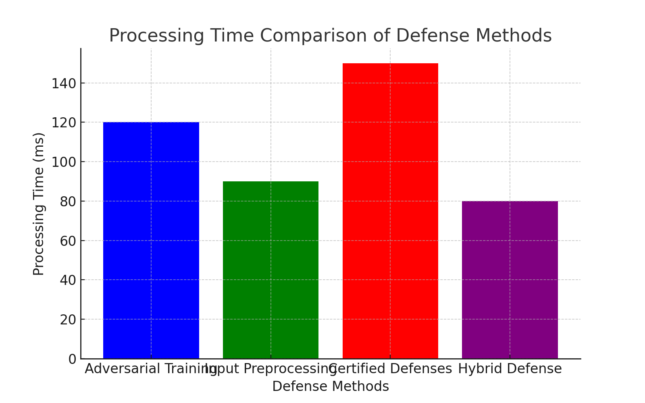
Real-Time Applicability
Real-Time Importance:
Self-driving cars need quick decisions—delays can be dangerous.
Challenge:
Many defences slow down the system. We need fast and safe solutions.
Solution:
Our method works quickly and doesn’t slow down the system, enabling safe real-time decisions.

Slide 17
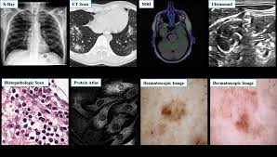
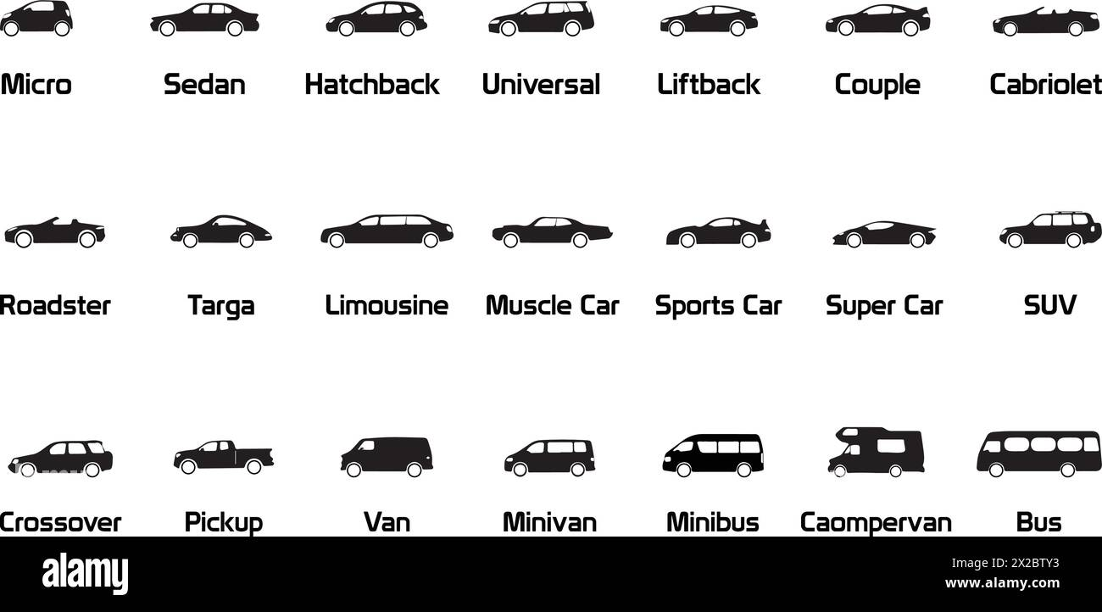


Cross-Domain Robustness
What is Cross-Domain?:
It means the defence works for different data types:
Images (e.g., medical images, stop signs)
Text (e.g., fake news detection)
Audio (e.g., voice recognition)
Why It Matters:
Most solutions work for just one data type, but we need to support multiple types for real-world use.
Fig 4. Medical scans
Fig 5. Image of diverse data car

Slide 18
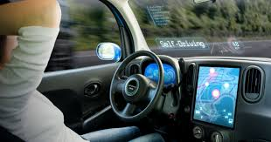

Impact on Critical Systems
Self-Driving Cars: Our defense will protect against attacks that could cause accidents.
Medical Systems: It will prevent attacks that could lead to wrong diagnoses.
Fraud Detection: It will help detect fraud more reliably, even against attacks.
Overall Impact: By improving security, our defense will make critical systems safer and more reliable.
Fig 6. self driving car
Fig 7. Fraud Detection

Slide 19
Literature Review
Adversarial Training: This method trains models to recognize attacks, but it can be slow and doesn’t always work for new attacks.
Input Preprocessing: This method modifies the data to remove hidden attacks, but it can reduce accuracy.
Certified Defenses: This method guarantees the system is safe, but it can be slow and needs a lot of computing power.
Research Gaps: There are no good solutions that combine all of these methods, especially for real-time systems or for different types of data.

Slide 20
1. Adversarial Attacks and Defenses in Deep Learning (ACM Link)
What it says:
Provides an overview of adversarial attacks targeting deep learning models.
Discusses existing defense mechanisms such as adversarial training, preprocessing techniques, and certified defenses.
Mentions that current defenses often struggle with generalization across different types of attacks and real-time applications.
How it relates to my project:
Supports your claim that adversarial attacks pose a major threat to ML systems.
Justifies the need for a hybrid defense combining multiple methods to improve robustness.
2. Ensemble Adversarial Training: Attacks and Defenses (ArXiv Link)
What it says:
Introduces ensemble adversarial training, where adversarial examples from multiple models are used to improve robustness.
Shows that adversarial training alone is not enough for real-world applications.
Highlights limitations, such as the high computational cost of adversarial training.
How it relates to my project:
Validates the use of adversarial training as one component of your hybrid defense.
Supports the idea that adversarial training alone is insufficient, reinforcing the need for input preprocessing and certified defenses.

Slide 21
3. Countering Adversarial Images Using Input Transformations (OpenReview Link)
What it says:
Proposes input transformations (e.g., image resizing, bit-depth reduction) to remove adversarial noise.
Shows that preprocessing can improve robustness against attacks without retraining models.
Mentions that preprocessing methods may slightly reduce accuracy on clean images.
How it relates to my project:
Supports the inclusion of input preprocessing as a key element in your hybrid approach.
Highlights the trade-offs of preprocessing (e.g., potential accuracy loss), which you may need to address in your paper.
4. Cyberattack Detection in Wireless Sensor Networks Using a Hybrid Intelligent Model (Springer Link)
What it says:
Uses a hybrid model to improve security in Wireless Sensor Networks (WSNs).
Combines ML and AI-based techniques for intrusion detection.
Demonstrates improved detection accuracy compared to traditional methods.
How it relates to my project:
Supports the argument that hybrid models work better in cybersecurity applications.
Suggests that your approach may also be useful in other security-critical domains beyond ML adversarial attacks.

